Slide 1
Understanding Compton Data Space & GRB Analysis
Gamma Rays, Compton Telescopes, and Practical Work with COSI
Presented by: Ghulam Mustafa
Date: 17/07/2025
Meeting: 02

Slide 2
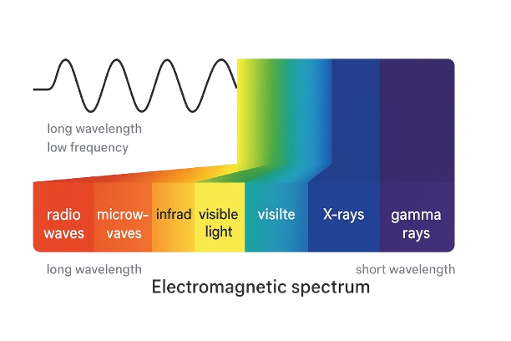
🔭 What is Gamma-Ray Astronomy?
Observes high-energy gamma rays from space.
Gamma rays come from black holes, neutron stars, supernovae, GRBs.
Requires space-based detectors (Earth’s atmosphere blocks gamma rays).

Slide 3
What is Compton Data Space (CDS)?
Compton Data Space (CDS) is a multi-dimensional space where each detected gamma-ray photon is represented by a set of physical parameters.
Each photon is stored in a 5-dimensional histogram:
Time – When the photon was detected.
Em (Energy) – The measured energy of the photon.
Phi (ϕ) – The Compton scatter angle (between initial and final direction).
Psi – Sky direction longitude (HEALPix coordinate).
Chi – Sky direction latitude (HEALPix coordinate).
👉 Psi and Chi together define the sky location of the scattered photon.

Slide 4
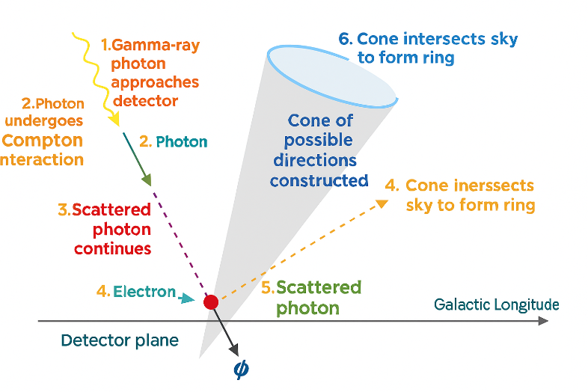
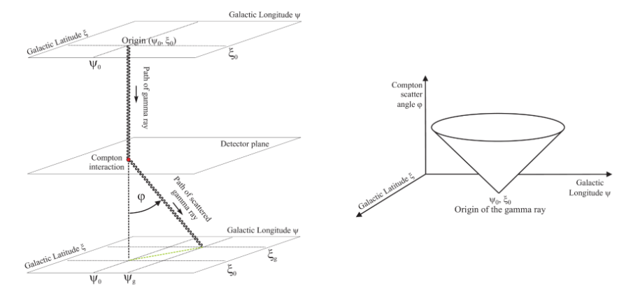
Useful references taht describes the CDS are e.g. Zoglauer+21(https://arxiv.org/pdf/2102.13158), Martinez-Castellanos+23(https://arxiv.org/abs/2308.11436).
The tip of the cone for small scattering angles corresponds to the location of the source in the sky.

Slide 5
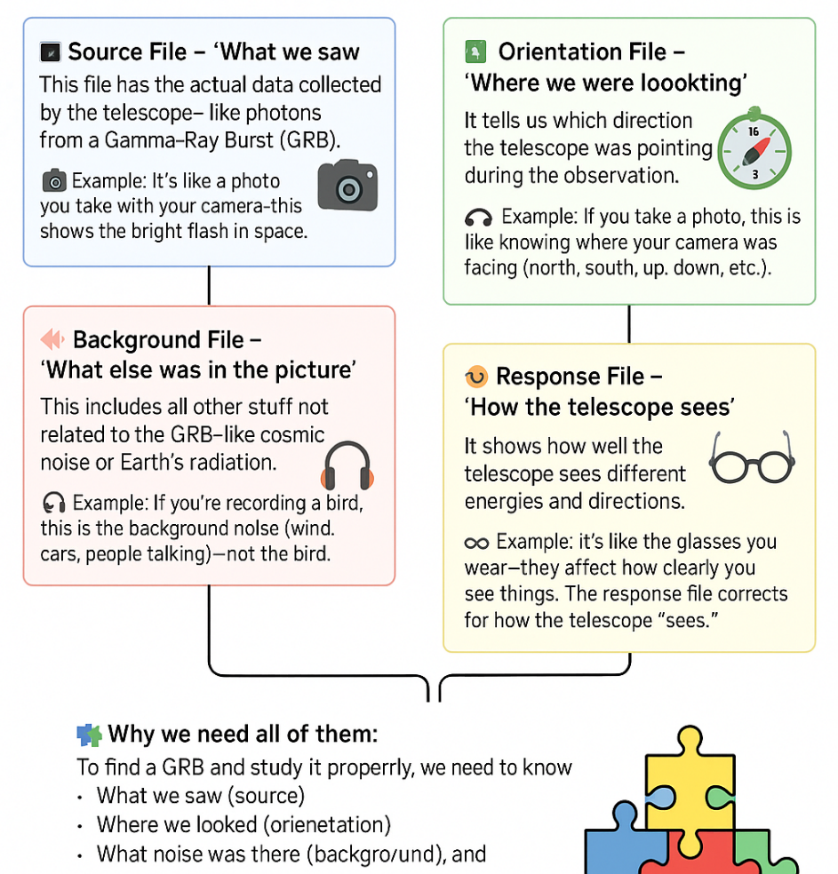
Files Needed in GRB Analysis
A 4-box diagram for:
Source File – actual GRB photon data
Orientation File – where the telescope was pointing
Background File – noise we want to subtract
Response File – how detector sees each photon
With everyday analogies (photo, GPS, background noise, glasses).
Together they allow TS maps and spectral fits.
Source + Orientation + Response + Background → TS Map

Slide 6
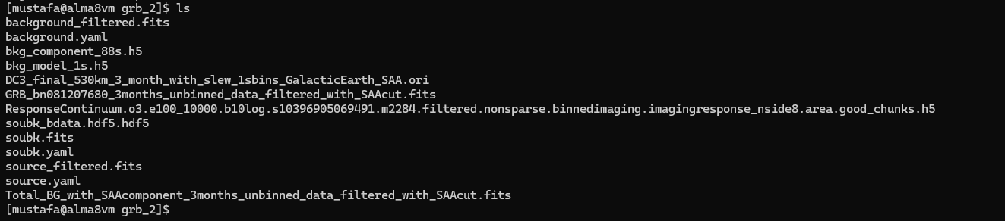
Files are Save in Data01 (Mounted Folder)

Slide 7
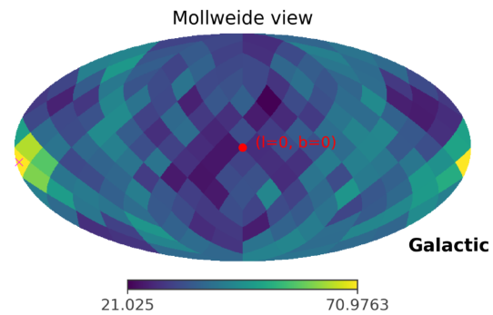
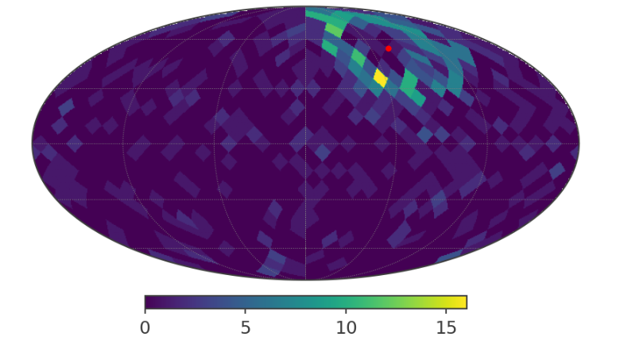
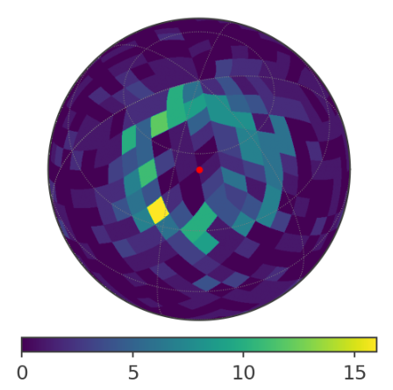
TS Map Results
bn081207680

Slide 8
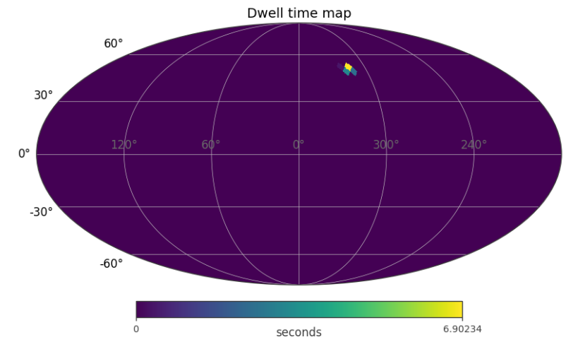
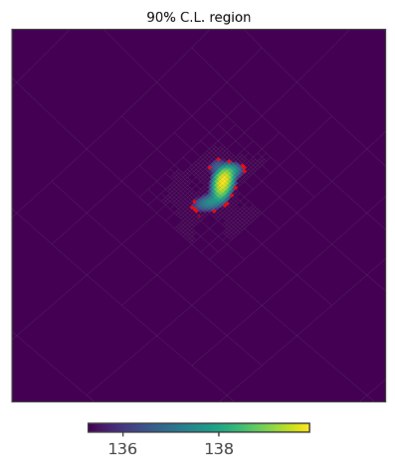
TS Map Results

Slide 9
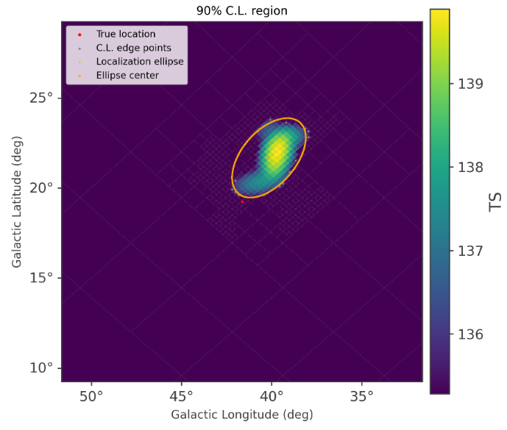
TS Map Results

Slide 10
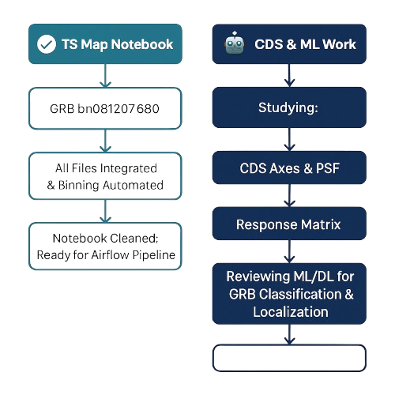
Project Progress – Ghulam Mustafa
✅ TS Map Notebook
GRB bn081207680 tested successfully.
All files integrated & binning automated.
Notebook cleaned; ready for Airflow pipeline.
CDS & ML Work
Studying:
CDS axes & PSF
Response matrix
Reviewing ML/DL for GRB classification & localization.

Slide 11
References:
Kierans, Takahashi & Kanbach (2022)
Schönfelder et al. (1993)
Zoglauer (2005), Diehl et al. (1992)
MEGAlib and Cosipy tools

